Slide 1
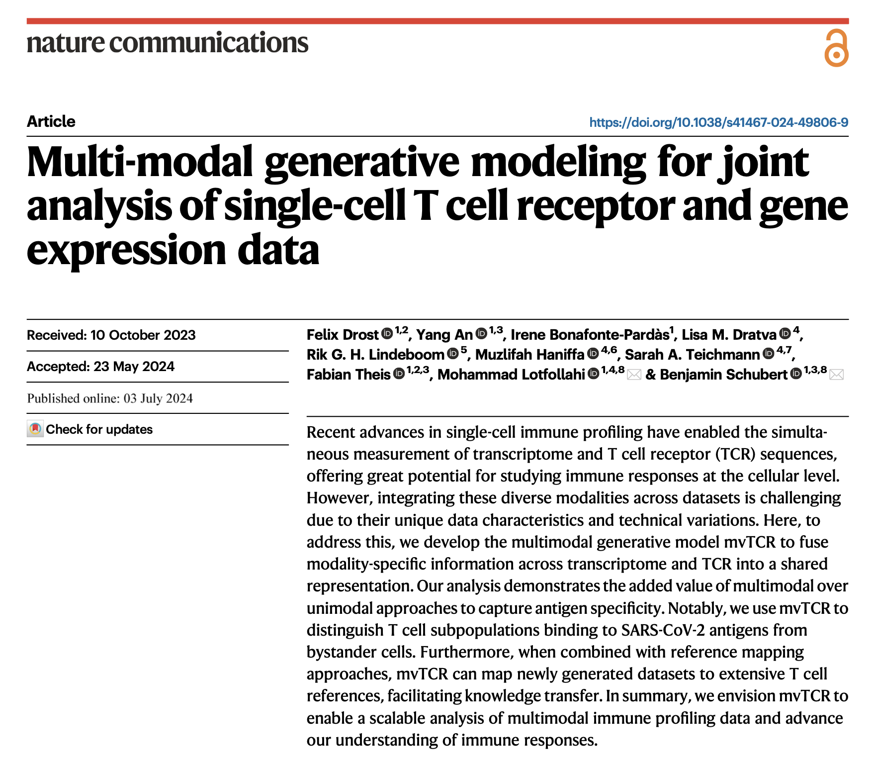
Journal club
9-3-2024
Ty Bottorff

Slide 2
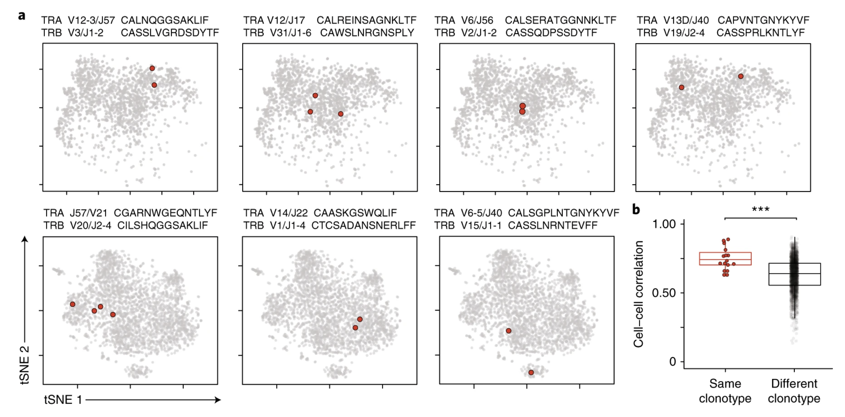
Clonotypes are often similar phenotypically
Zemmour et al. (2018) Nat Immunol
Notes:
Clonotype uniquely identifies cell lineage
T^{regs} that express the same TCRαβ sequence have related transcriptional programsa. Two-dimensional tSNE plot of T_{regs} from the colon lamina propria, in 7 panels to highlight in red single T_{reg} cells with the same rearranged TCRαβ sequences. V/J alleles and CDR3 sequences indicated above each panel. Data from 2 different experiments (top 4 and bottom 3 panels).
b. Cell-cell correlation between colonic T_{reg} cells that express the same rearranged TCRαβ, or unrelated TCRs , *** p < 10⁻⁴(t test p value).

Slide 3
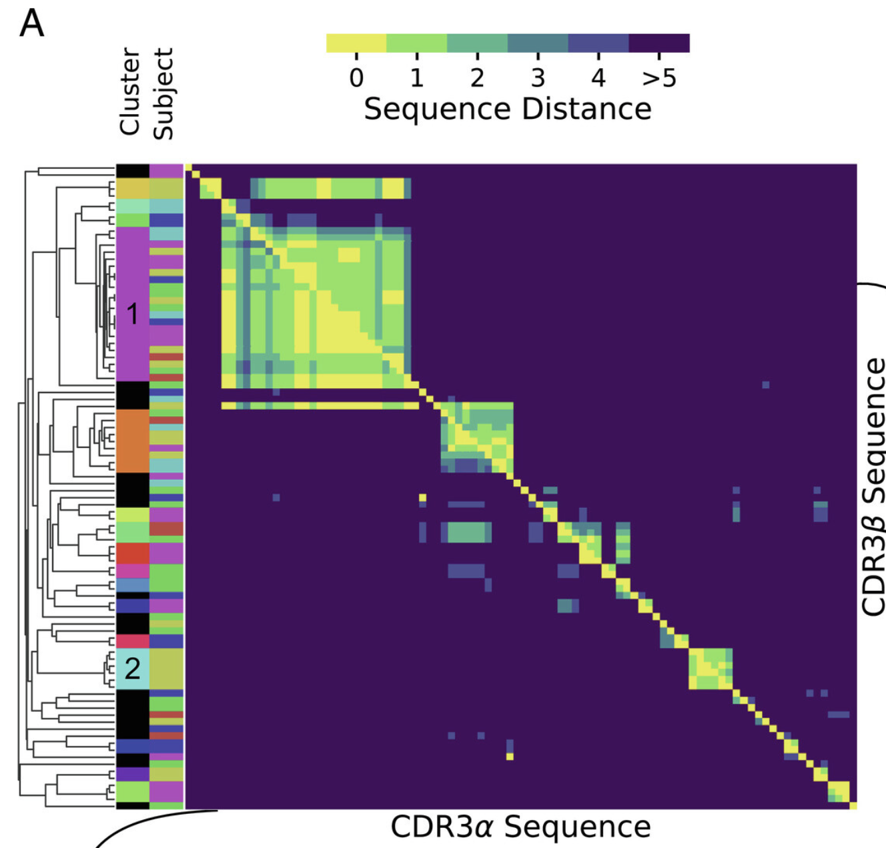
TCRs with similar sequences often bind same epitope, but dissimilar TCRs may bind same epitope (distinct binding mode)
A) Sequence-similarity cluster map of TCRs binding to an Epstein-Barr Virus epitope as obtained by single-cell TCR sequencing following tetramer sorting (Data: Dash et al. (14), antigen BMLF). Lower (Upper) triangle shows pairwise distances of CDR3α (CDR3β) sequences. Sequences are ordered by average linkage hierarchical clustering based on summed αβ distance. Columns on the left show the subject of origin and cluster assignment; sequences not belonging to a cluster based on a cutoff distance of 6 are shown in black.
Mayer & Callan Jr. (2023) PNAS
Notes:
Above diagonal is difference in beta chain between 2 clones, below diagonal is alpha
So you see
While TCRs with similar sequences often—but not always—recognize the same epitope19, dissimilar TCRs may bind the same epitope through distinct binding modes20, which poses a major challenge for approaches purely based on sequence similarity.
Fig. 1A shows a clustering by pairwise amino acid sequence distance of all distinct nucleotide sequence clones. In this visualization, each position in the heatmap records the sequence distance Δ between the amino acid sequences of a pair of distinct T cell clones. TCRs are heterodimeric, and the heatmaps above (below) the diagonal record distances between the β(α) hypervariable complementary-determining region 3 (CDR3) loops of the sequence pair. Clustering is based on the sum of distances between α and β chains. Here, and throughout this work, we define sequence distances as the minimal number of edits (insertions, deletion, or substitutions) that change one sequence into another, known as the Levenshtein distance. We only consider sequence distances between CDR3 loops for simplicity, but the mathematical framework we develop is general and could also be used with distance measures that include other hypervariable receptor regions. By clones we mean lineages of cells that go back to the same ancestral recombination event, which we define in practice based on nucleotide sequence identity. A zero distance pair arises when due to convergent recombination two distinct nucleotide sequences have the same amino acid translation. We chose to ignore the number of times a given nucleotide sequence is sampled, as clone sizes also reflect TCR-independent lineage differences (31, 32). Instead, we analyze convergent selection imposed on distinct clones with the same or similar TCR as a stringent measure of epitope-driven functional selection. In the experiments that we consider in this manuscript, TCRs are selected for binding to a specific pMHC ligand, and our analysis quantifies the imprint of this filtering funnel on TCR sequence statistics. We use the word “selection” to refer to this filtering process, which is distinct from, and not to be confused with, thymic selection.

Slide 4
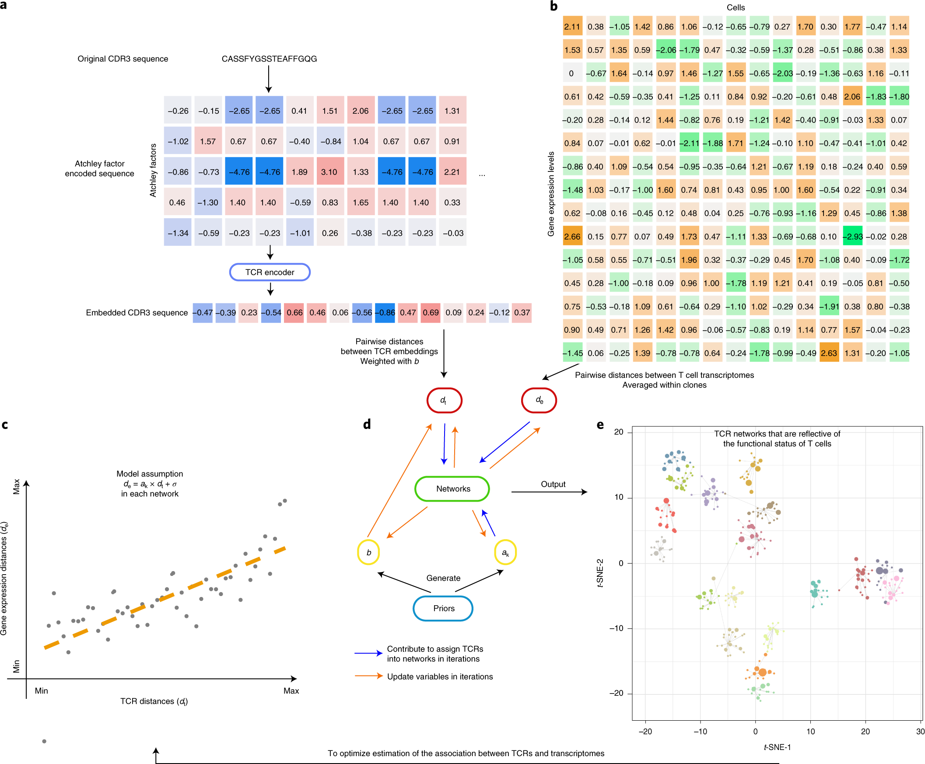
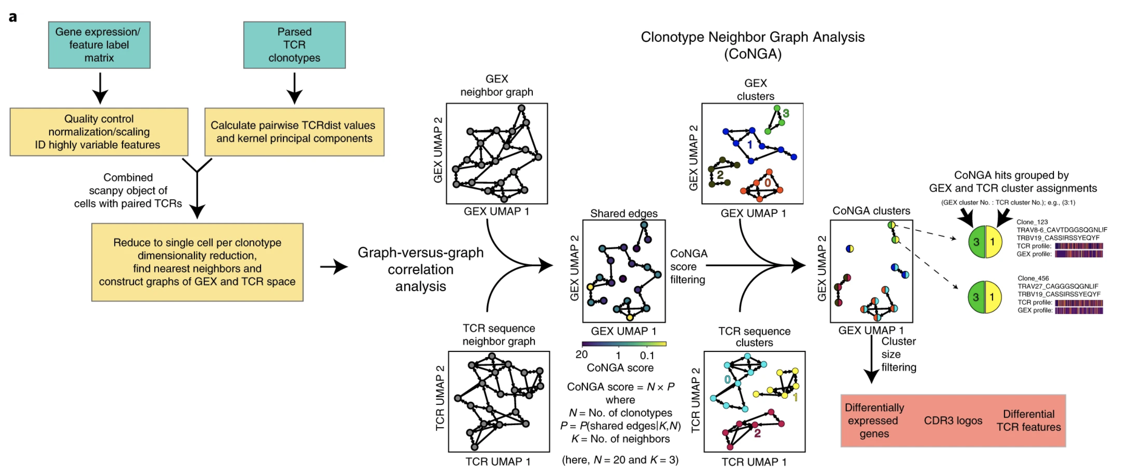
Previous methods relied on correlations between unimodal analyses or were only at clonotype level
CoNGA: Schattgen et al. (2021) Nature Biotechnology
tessa: Zhang et al. (2021) Nature Methods
Notes:
CoNGA identifies correlation between T cell GEX and TCR sequence by constructing a GEX similarity graph and a TCR sequence similarity graph and looking for statistically significant overlap between them. Overlap is assessed on a per-clonotype basis by counting the number of edges that originate at each clonotype and are shared between the two graphs or, equivalently, by measuring the overlap between each clonotype’s GEX graph neighbors and its TCR graph neighbors and assigning a score that reflects the likelihood of seeing equal or greater overlap by chance (the CoNGA score). Clonotypes with CoNGA scores below a threshold are grouped based on shared GEX and TCR cluster assignments into CoNGA clusters. Clonotypes within each CoNGA cluster carry their initial GEX and TCR cluster identities, which are combined together and used as a group ID for the CoNGA cluster.
a, A flowchart shows how the TCR sequences are encoded into numeric vectors that are amenable for mathematical operations. b, A heatmap indicating the scRNA-seq expression matrix, which was used to calculate the expression distances, and serves as another input into the tessa model. c, The core rationale of tessa: to combine the information from TCR and RNA expression. d, The two key processes of the tessa model to combine the information iteratively: updating variables to maximize the association in c and updating TCR network assignments according to the updated variables. e, A t-SNE plot intuitively shows tessa-identified networks of TCRs, which has incorporated expression information and can help achieve more refined estimation of the association in c within each network.
Same clonotypes can have distinct phenotypes
integration tools exist for other modality combos like RNA + surface protein, they aren't adapted for TCR
Scirpy, scRepertoire: interlinked unimodal analyses
CoNGA: detect correlations between TCR sequences and transcriptome
tessa: correlate modalities and cluster T cell clones by specificity
Gap in methods: no integrated representation for downstream analyses, scaled only to small-size datasets, only clonotype-level approaches

Slide 5
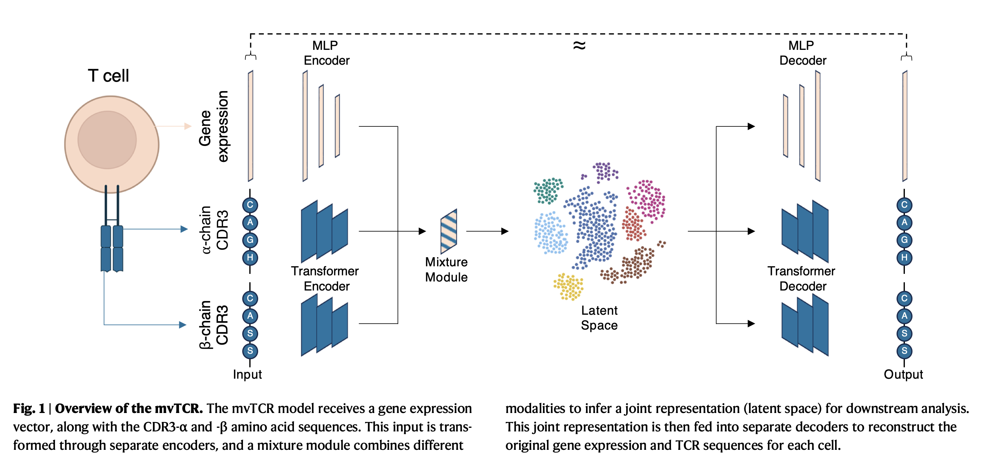
mvTCR: a multi-view deep learning generative model for integrating TCR and transcriptome
Notes:
Given the availability of paired scRNA + scTCR multiomic data
hopefully providing value over unimodal approaches (identify groups of functionally/clonally linked T cells) → better understand inter-dependencies between these 2 modalities, added value of multimodal over unimodal approaches to capture antigen specificity
multimodal generative model based on a deep variational autoencoder, fuse modality-specific information across transcriptome and TCR into shared representation, mvTCR provides a cell-level embedding incorporating both modalities
multi-layer perceptron (MLP) to 1) embed gene expression data to lower-dimensional representation, and 2) aggregate residue-level representation of TCR (each residue’s importance weighed, this is from transformer-based encoders that processed AA seqs to lower-dimensional representations, concatenated across beta/alpha) to derive seq-level TCR representation
Then, after encoding both modalities individually, mixture model used to fuse modalities into a shared representation for each cell
Concatenation: combines both latent embeddings as input to additional encoding network estimating distribution
Product of experts: first estimates separate marginal posterior distributes, then fused via multiplication to form joint posterior distribution
Mixture of experts: same as PoE but addition instead
Both CDR3 sequences are tokenized and zero-padded to themaximal sequence length seq present in D
5000 most highly variable genes, whose read counts were normalized and log1p-transformed
Goal: enrich transcriptomic info w/ clonality → find DEGs and TCR feature differences of clusters that depend on both transcriptome & TCR (specificity), missed in unimodal approach

Slide 6
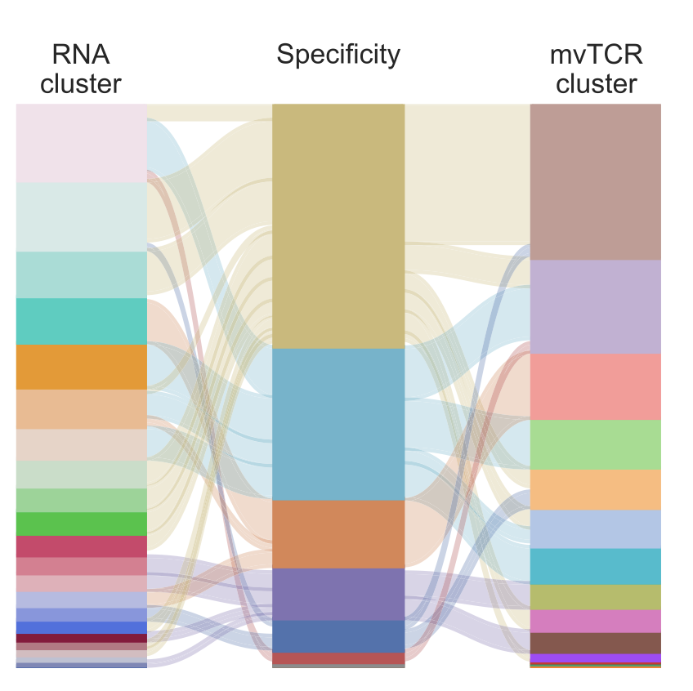
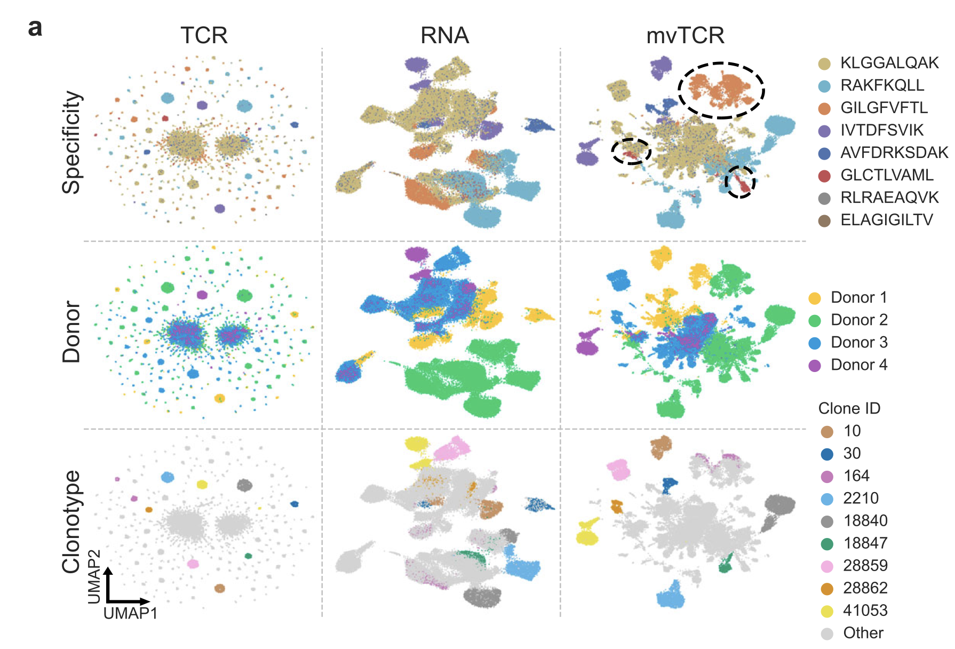
mvTCR’s joint representation better represents specificity groups then unimodal analyses
a UMAP visualizations comparing the embeddings of the unimodal (RNA, TCR) and the multimodal mvTCR models colored by peptide-MHC (pMHC) specificity, donor, and ten largest clonotypes. B Comparison of RNA clusters to mvTCR clusters with respect to antigen specificity
Notes:
Some epitopes only had some donors binding to them → donor “biased” UMAPs
Motivation: does joint embedding improve prediction of antigen specificity?
Data from 10x genomics w/ binding annotations of 44 epitope pMHCs from 4 donors, T cells specific to 8 most common pMHCs, ~61k cells
representations were clustered via the Leiden algorithm21, where the resolution was chosen to maximize the NMI (success metric) between pMHC specificity (ground truth) and cluster annotation (prediction)
Unimodal TCR UMAP dominated by large clonotypes (many clusters, many clonotypes)
They highlight some mvTCR clusters not present in unimodal UMAPs that captured subpopulations of cells specific to an epitope
While 94.4% of the T cells specific to GILGFVFTL fall into three RNA clusters, 96.5% are contained in only one mvTCR cluster of 99.2% purity (Fig. 2b).
Seeing same clonotypes in same RNA clusters is consistent with their usual phenotypic similarity

Slide 7
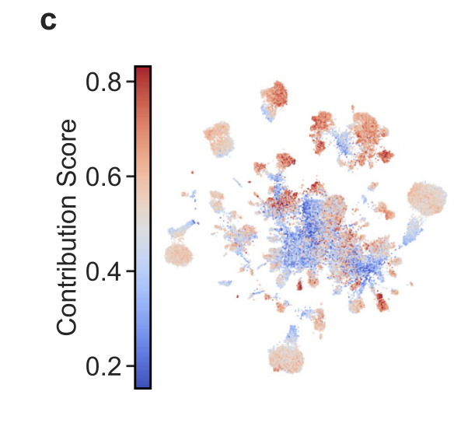
Contribution of each modality to joint representation varies
c UMAP visualization colored by the contribution of TCR sequence information on the joint representation. Values <0.5 represent the dominance of RNA information and values >0.5 the dominance of TCR information.
Notes:
To investigate the influence of each modality on the learned representation, we devised a mechanism to infer modality-specific scores (Methods TCR-Contribution).
Means what model prioritizes more (RNA or TCR info) for specific cells relative to other cells
These contribution scores range from complete RNA dominance at 0% to only TCR information at 100% (Fig. 2c) and represent the respective similarity between ziRNA and ziTCR to zijoint
mvTCR complements its joint embedding with information from both transcriptome and TCR sequences, leading to a more holistic cell representation capturing phenotype and functionality at the same time
TCR similarity estimated by the well-established TCRdist method¹⁹, which also indicated an elevated TCR sequence similarity for specificity groups of high TCR-contribution

Slide 8
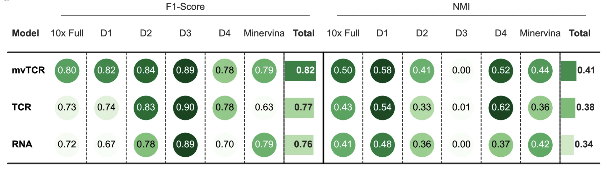
Usually, mvTCR captures antigen-specificity better than unimodal approaches
a Predictions of antigen specificity were made on the 10x Genomics dataset for all donors (10x Full), donors 1-4 separately (D1-D4), and the Minervina dataset. Each score represents the average over five random splits (n = 5).
Notes:
Retrain mvTCR on 10x dataset pooled over all donors (10x full) and separately for each donor on 5 random splits. Include Minervina dataset (has specificity info for pMHCs against 18 Sars-cov-2 epitopes for ~9k cells from 55 donors). Train model, then use hold-out set (all new clonotypes, projected onto training set) to predict specificities of cells
MoE performed better on average than the PoE and the Concatenation mixture module at fusing TCR and RNA info
Specificity often dominated by TCR or RNA info, mvTCR focuses on relevant info while being trained knowing which cells are specific for what epitope (i.e. depends on dataset/donor if RNA or TCR info more relevant for predicting specificity)
when cells of the same clonotypes have more diverse gene expression profiles in a dataset mvTCR incorporates less TCR information

Slide 9
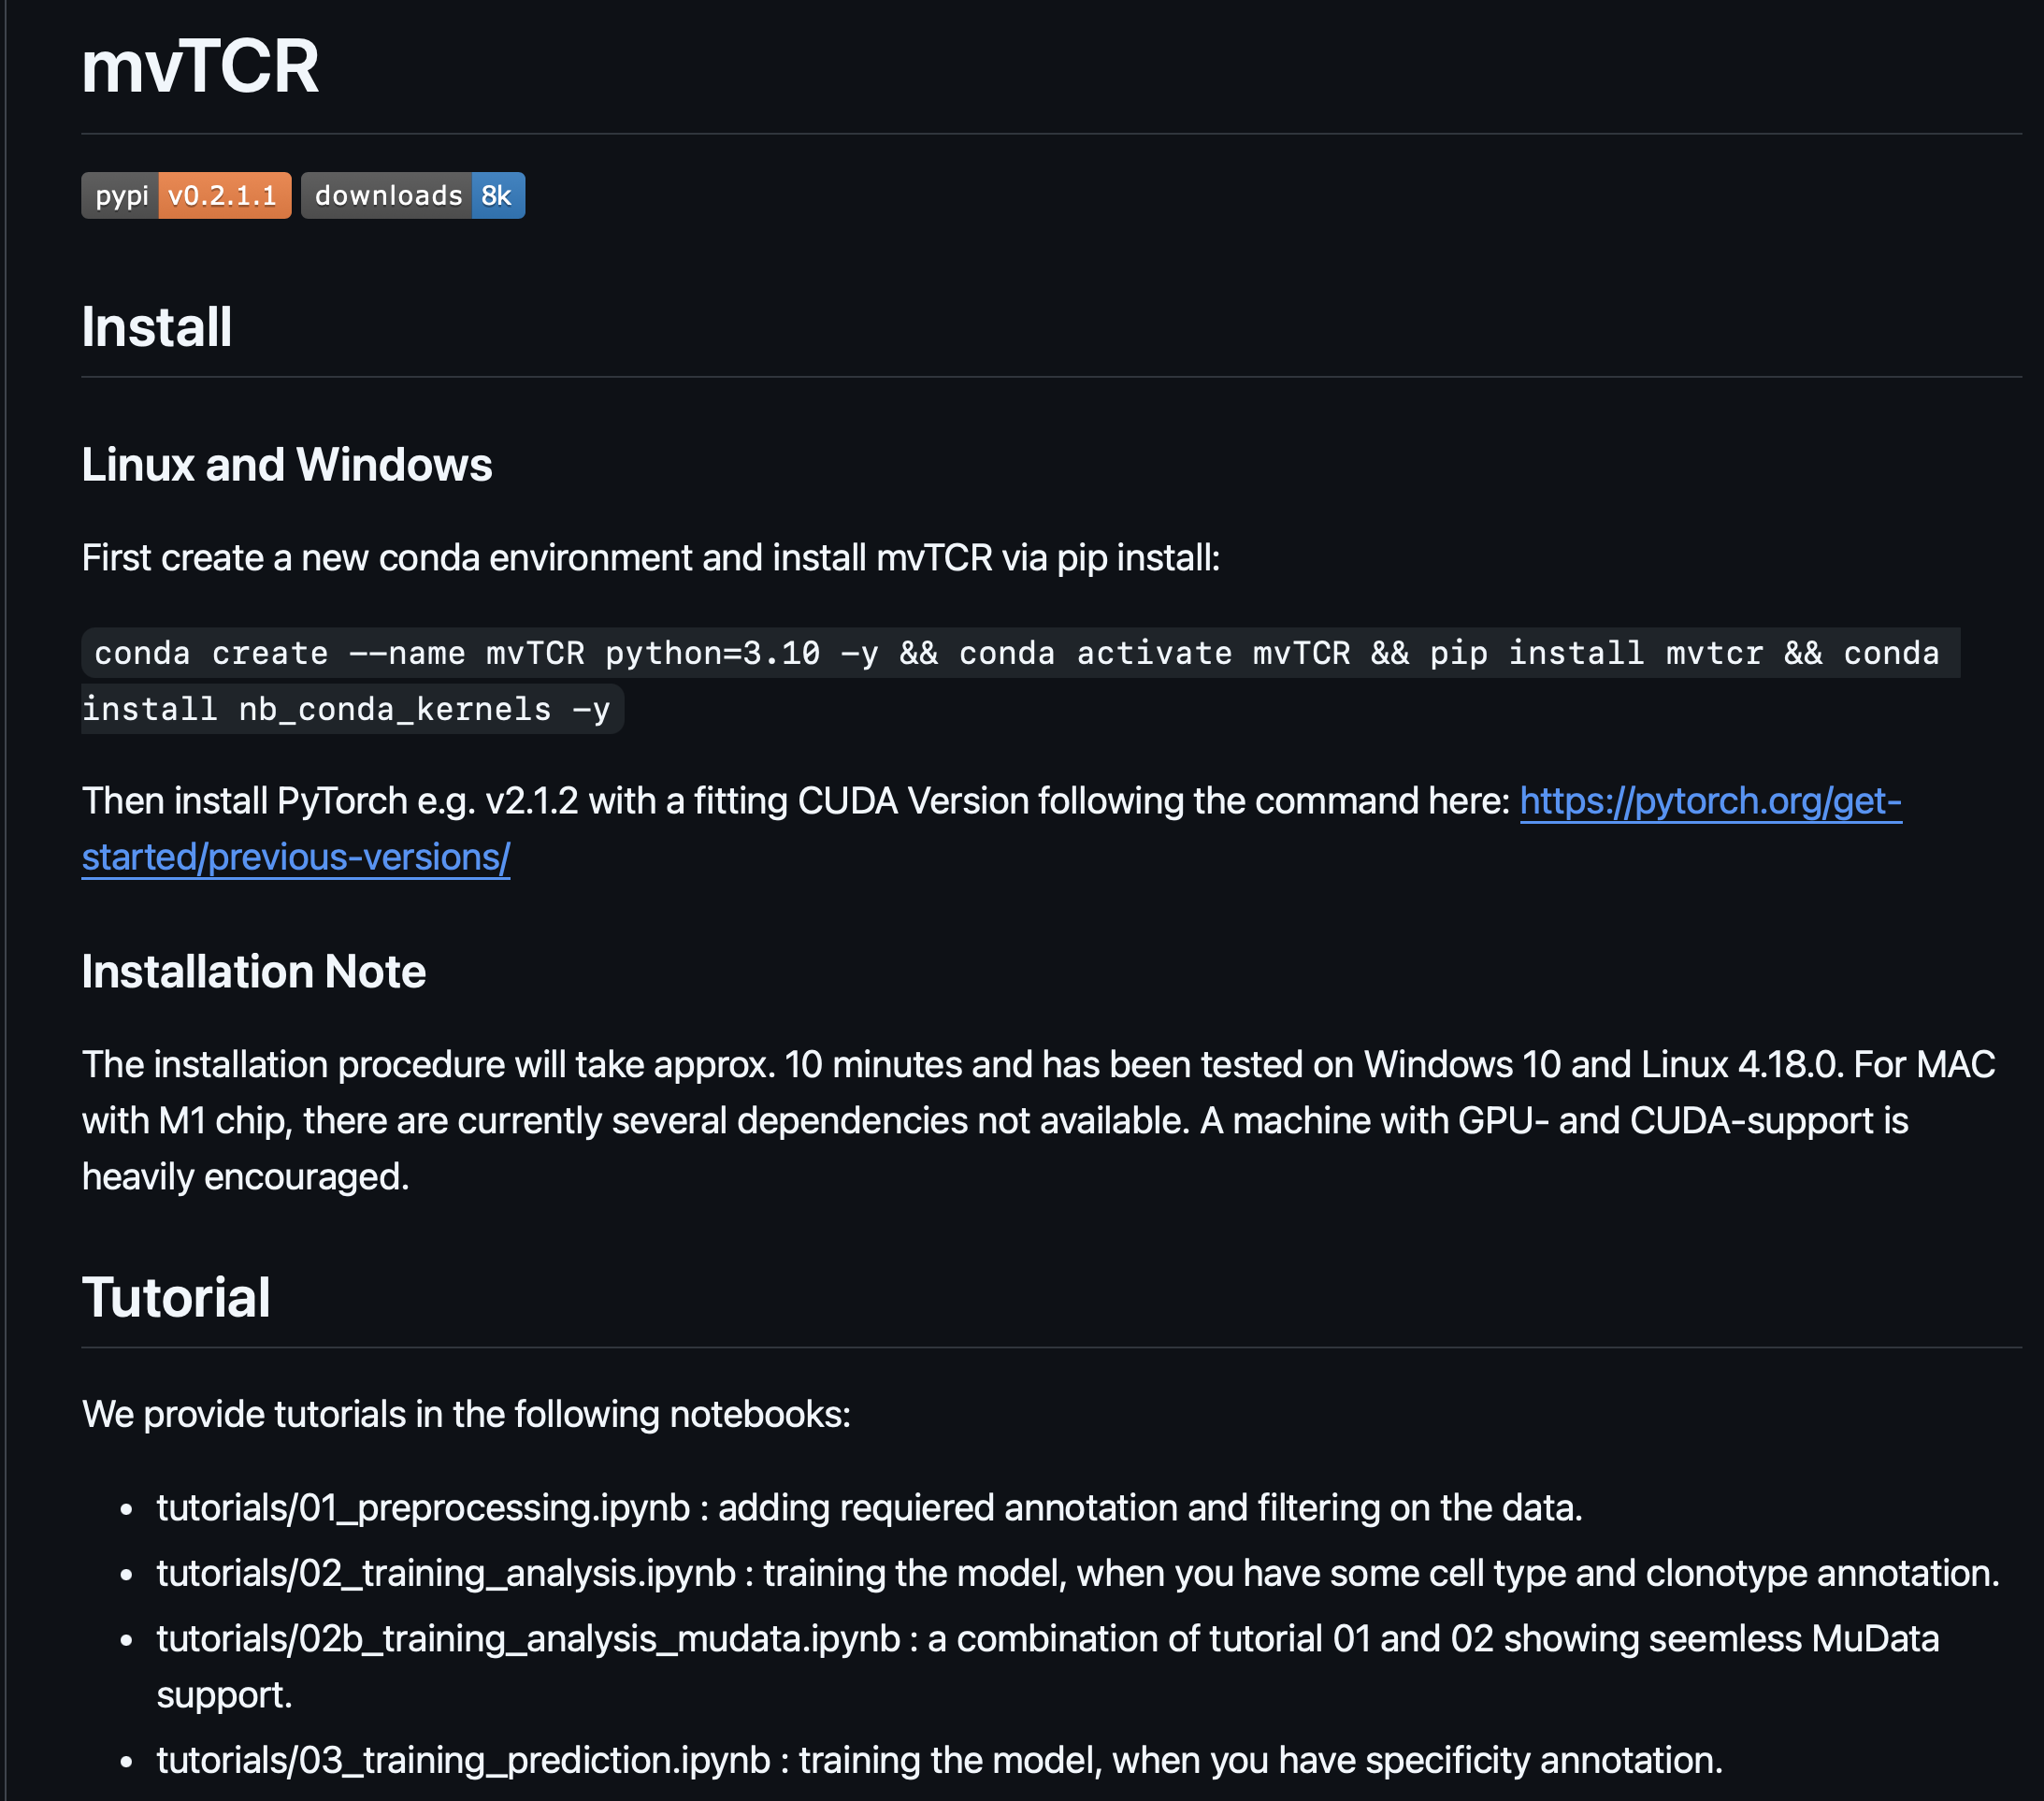
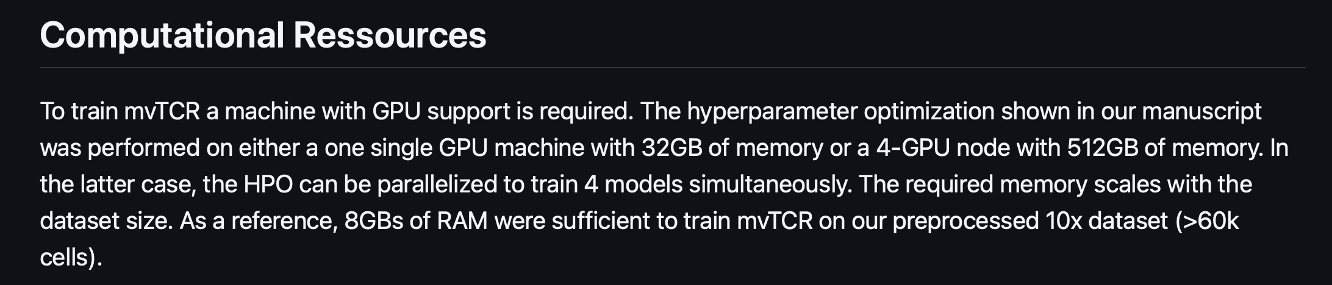
Using mvTCR

Slide 10
Extra slides

Slide 11
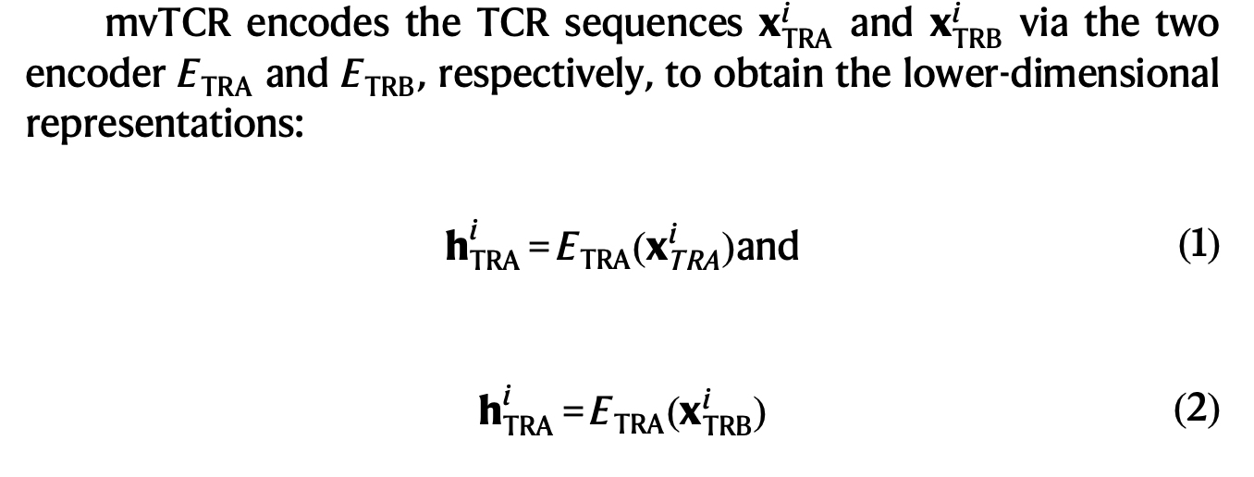
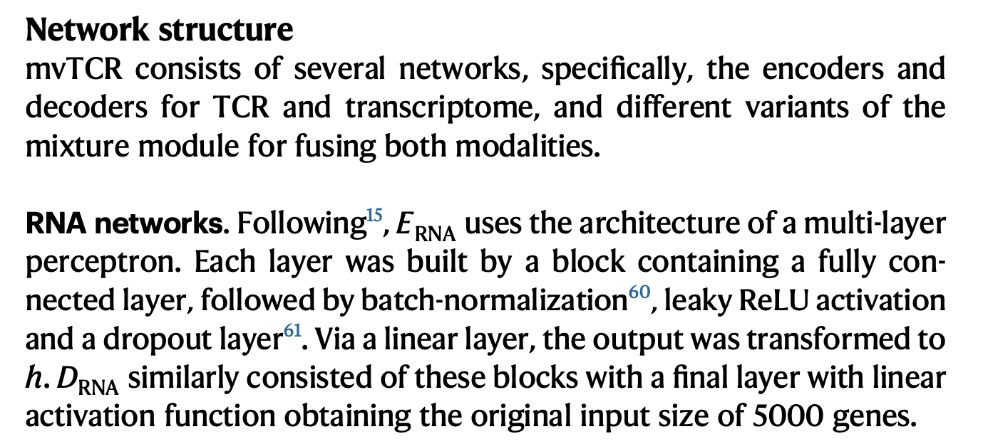
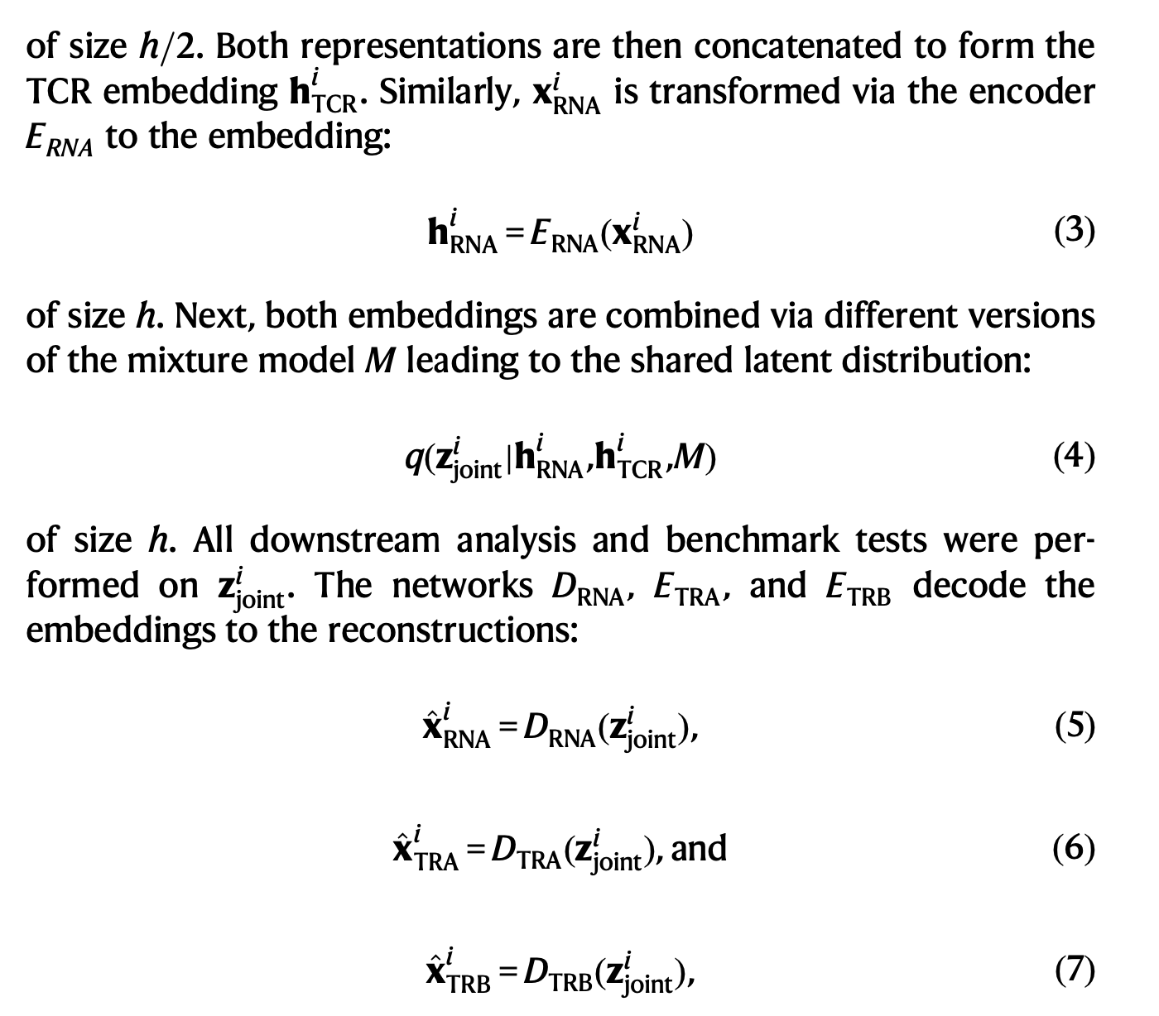
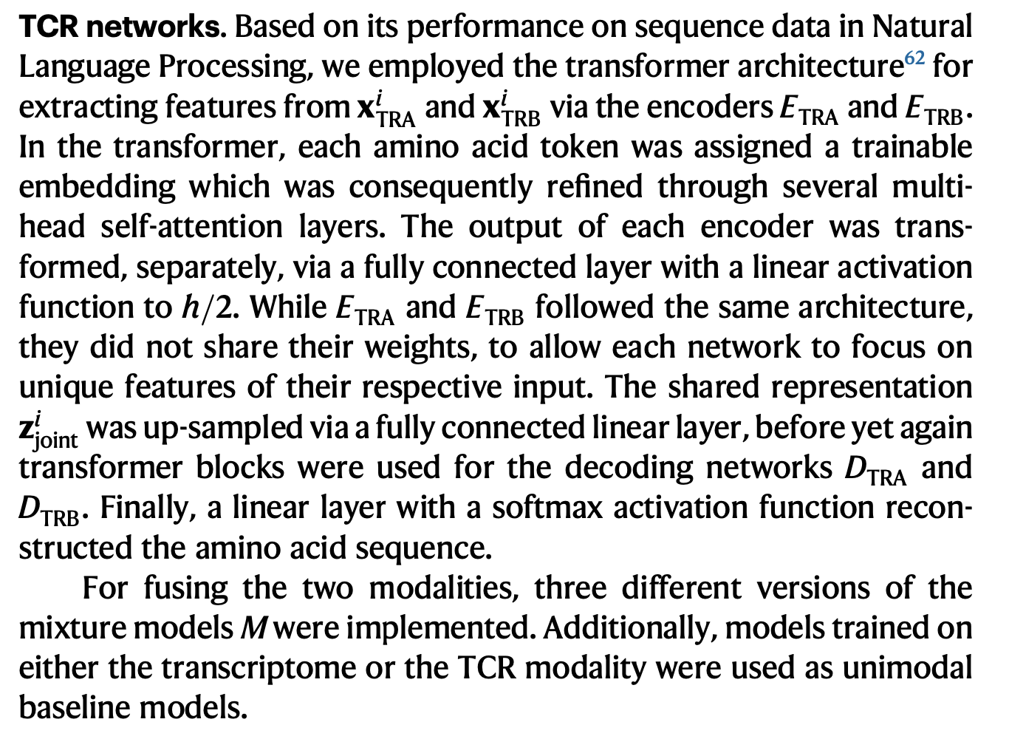
Methods

Slide 12
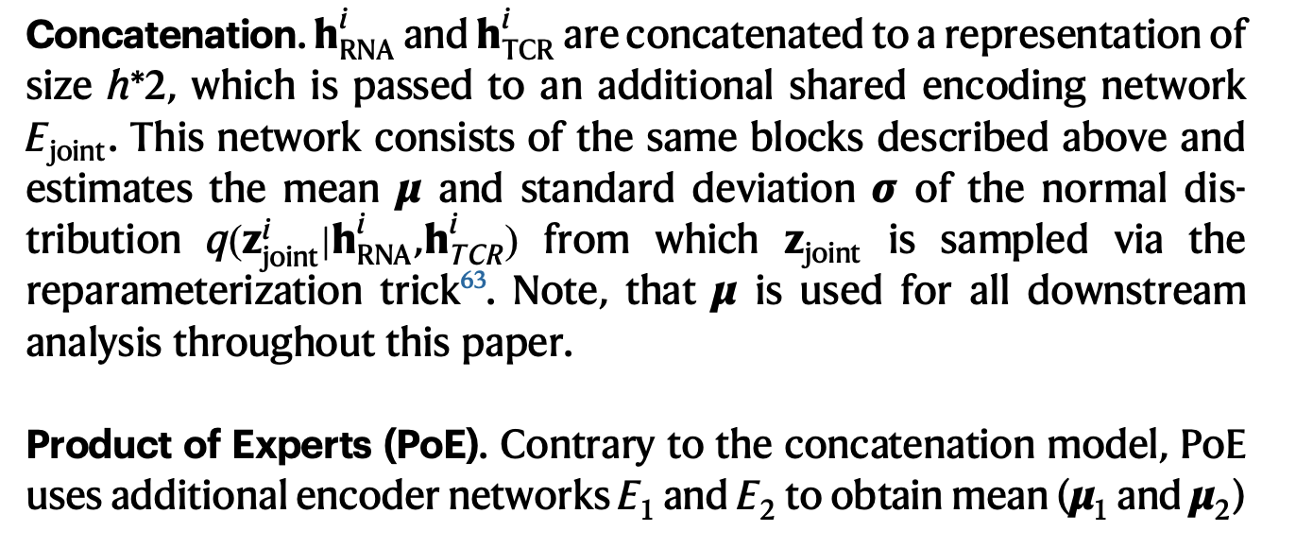
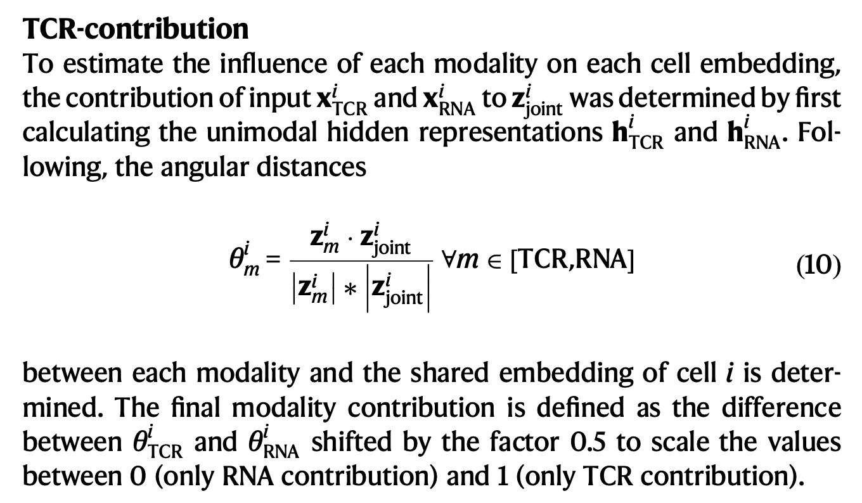
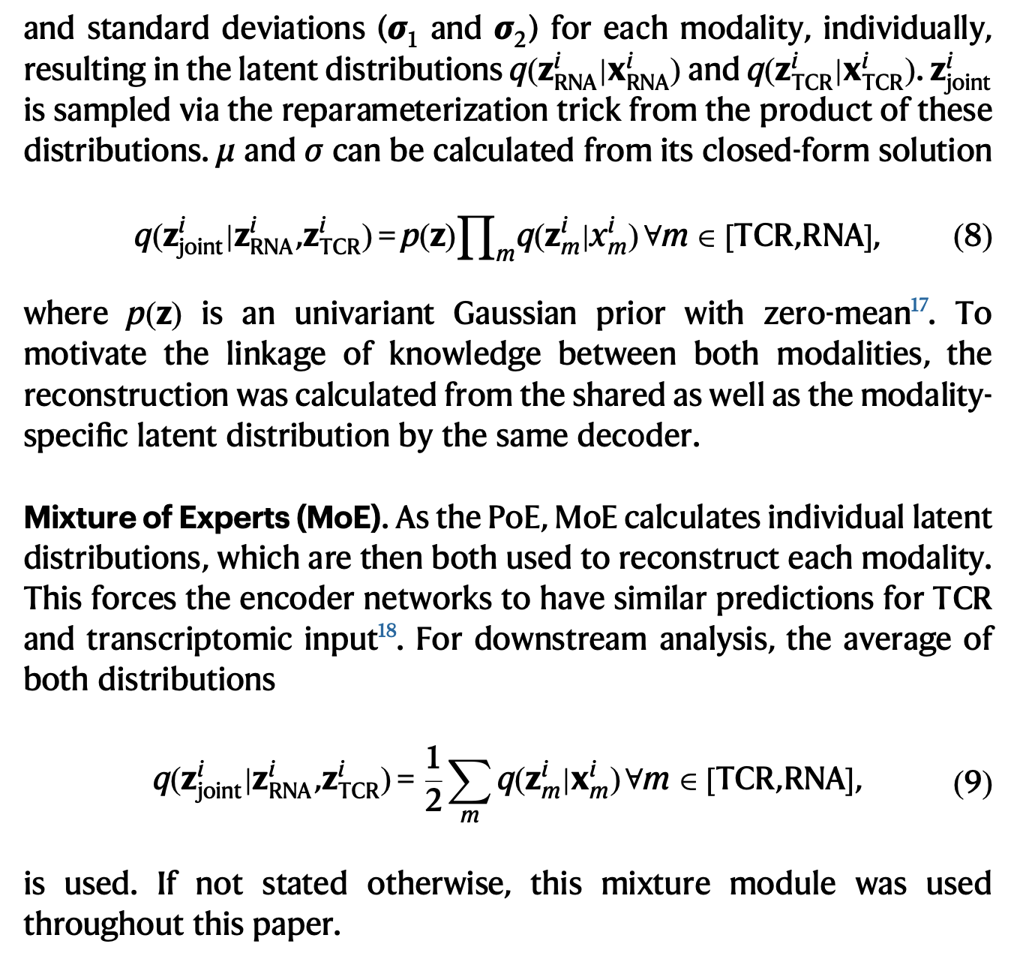
Methods

Slide 13
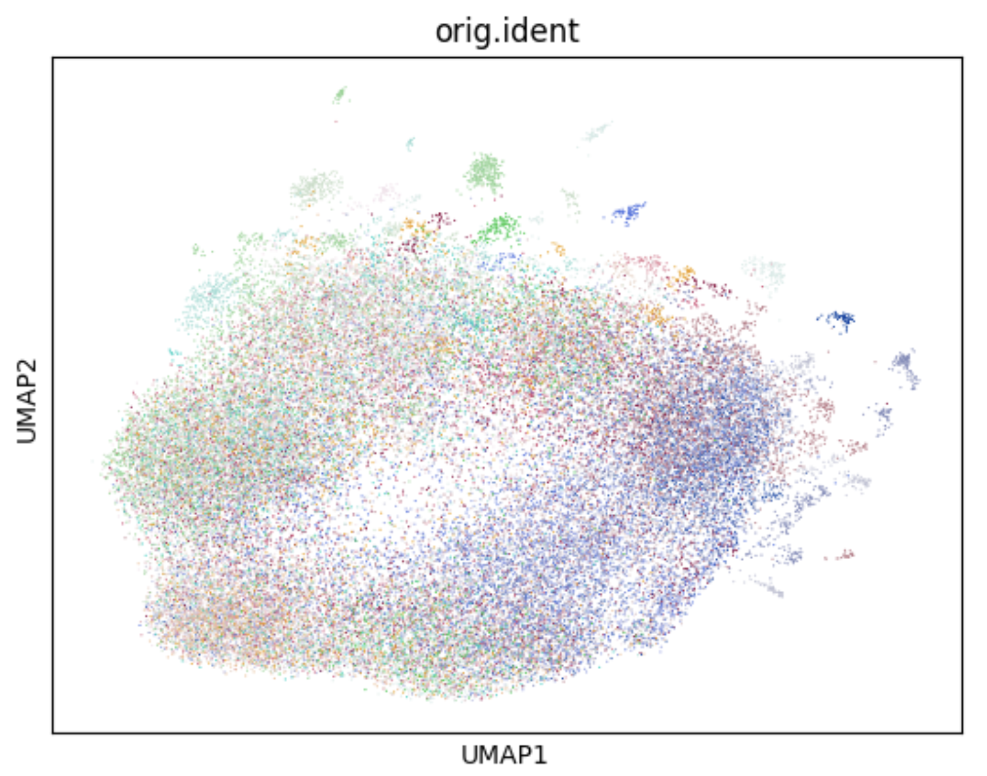
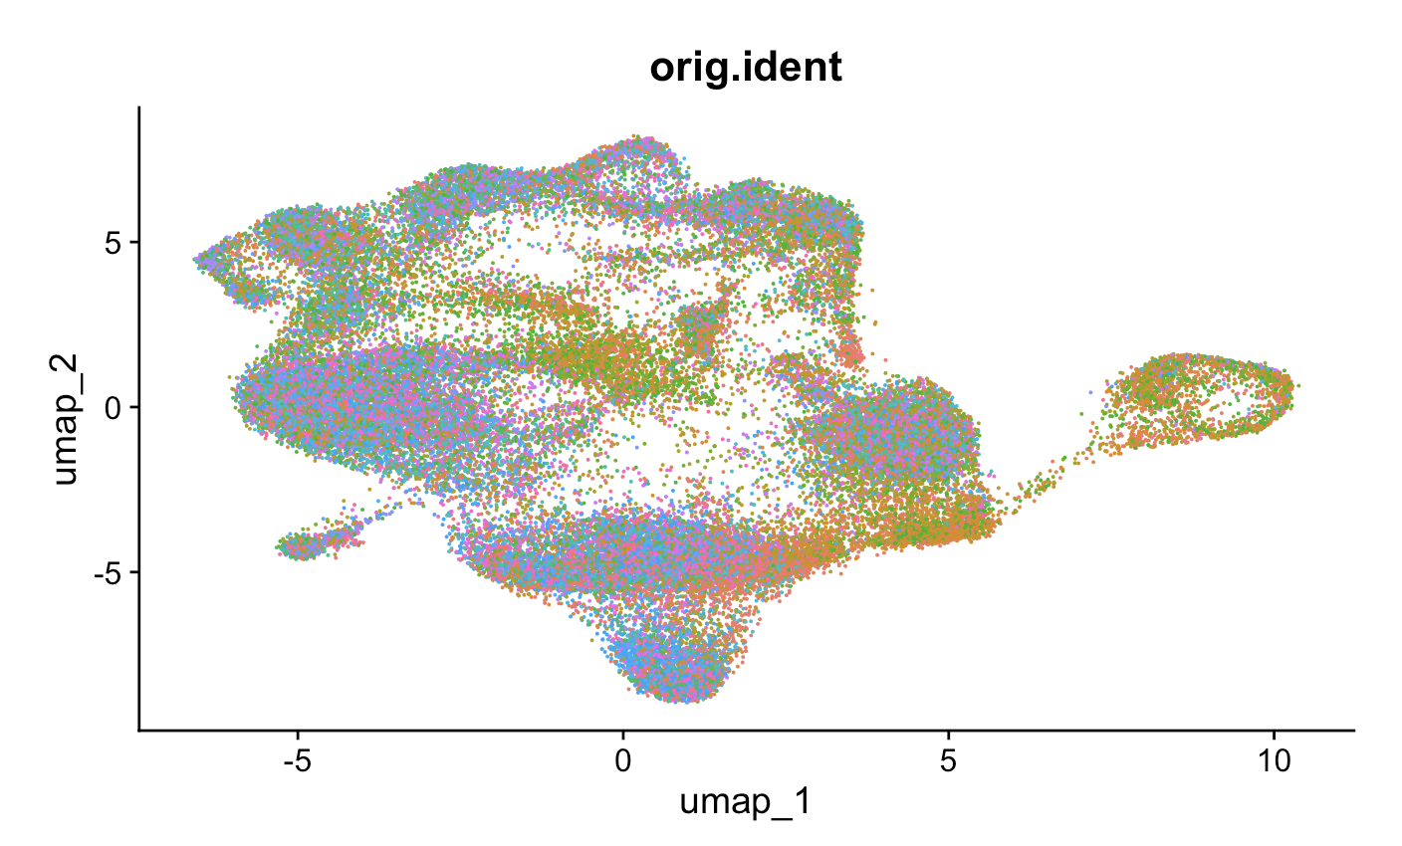
RNA (Seurat) vs. RNA+TCR (mvTCR) UMAPs: patient ID
RNA
RNA + TCR

Slide 14
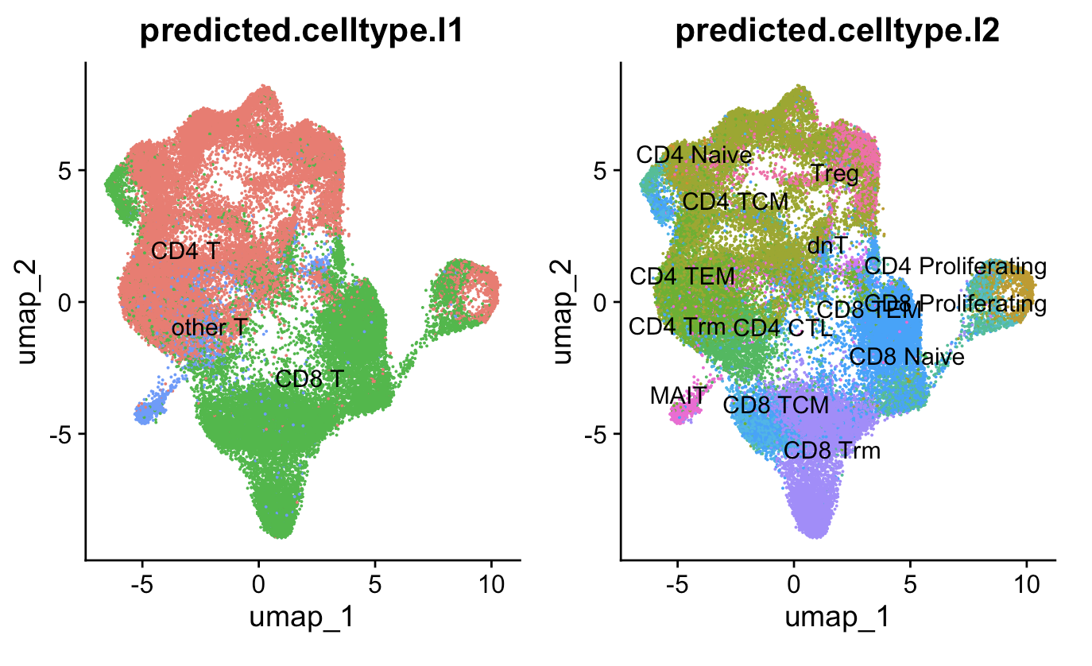
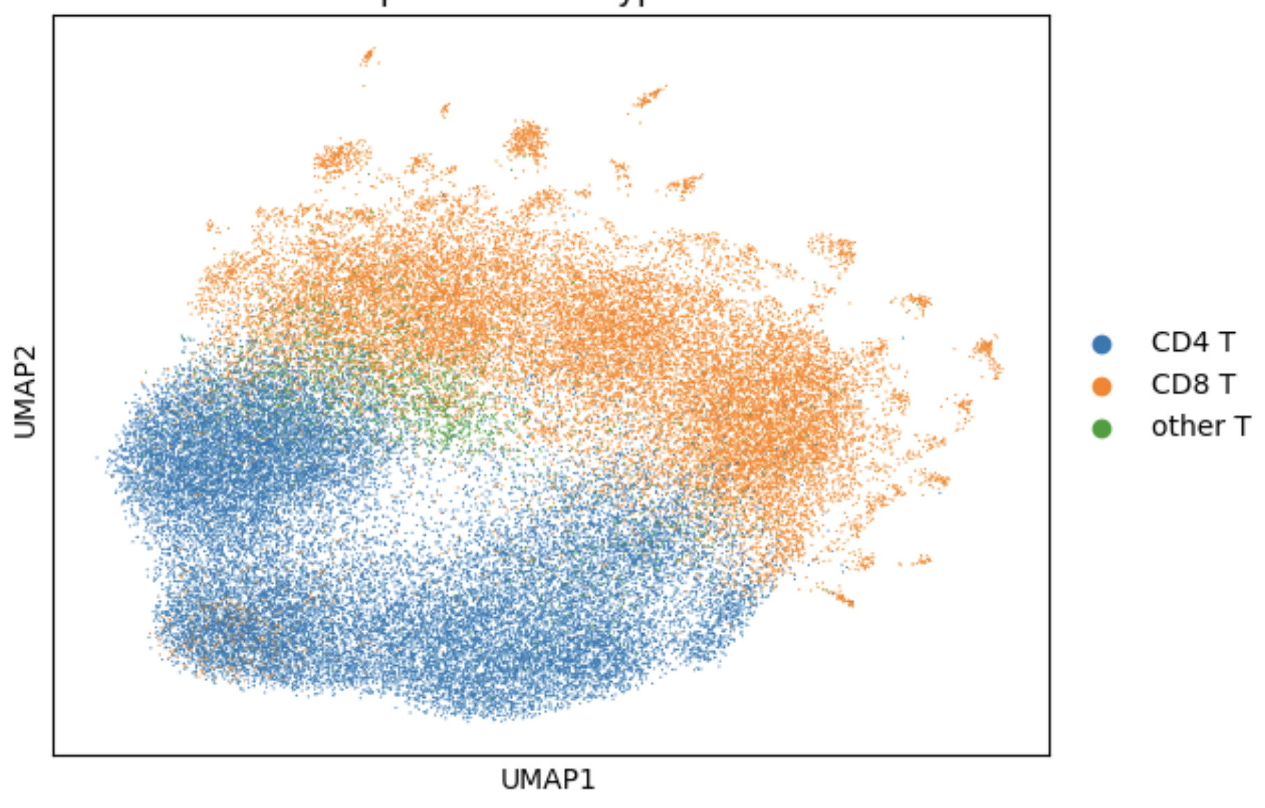
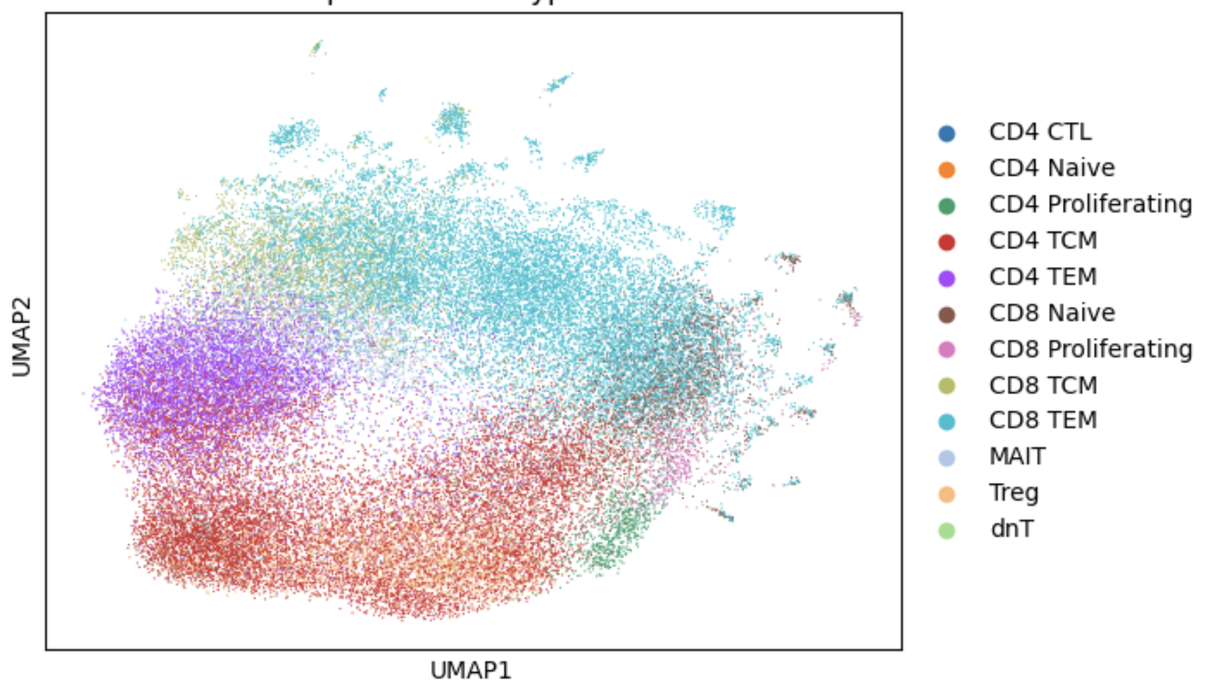
RNA (Seurat) vs. RNA+TCR (mvTCR) UMAPs: cell type
RNA
RNA + TCR
Notes:
NEXT STEP: identify the DEGs/TCR feature differences of clusters which depend both on specificity and transcriptional signatures

Slide 15
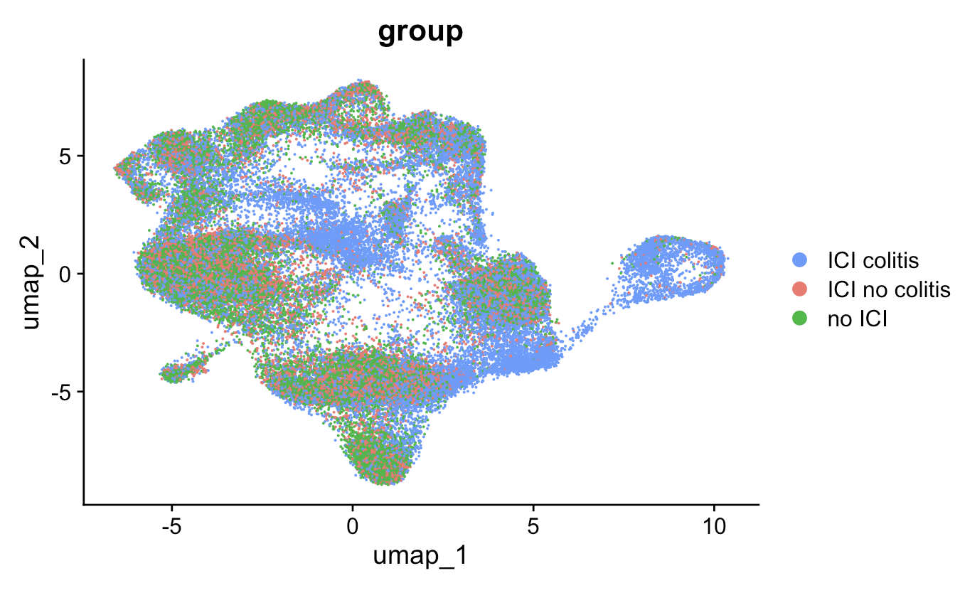
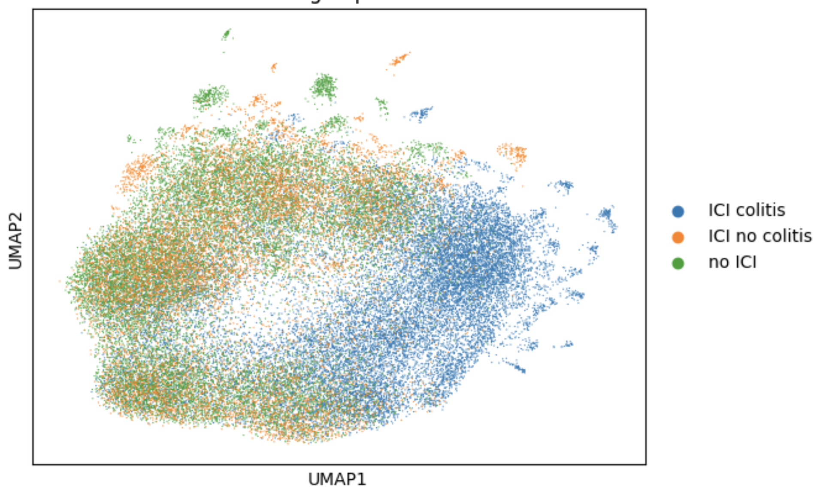
RNA (Seurat) vs. RNA+TCR (mvTCR) UMAPs: irAE status
RNA
RNA + TCR
Notes:
NEXT STEP: identify the DEGs/TCR feature differences of clusters which depend both on specificity and transcriptional signatures, DOING THIS BEFORE HERE SAW NO DEGS/TCR feature diffs BUT MAYBE NOW I WOULD SEE SOME DEGs

Slide 16
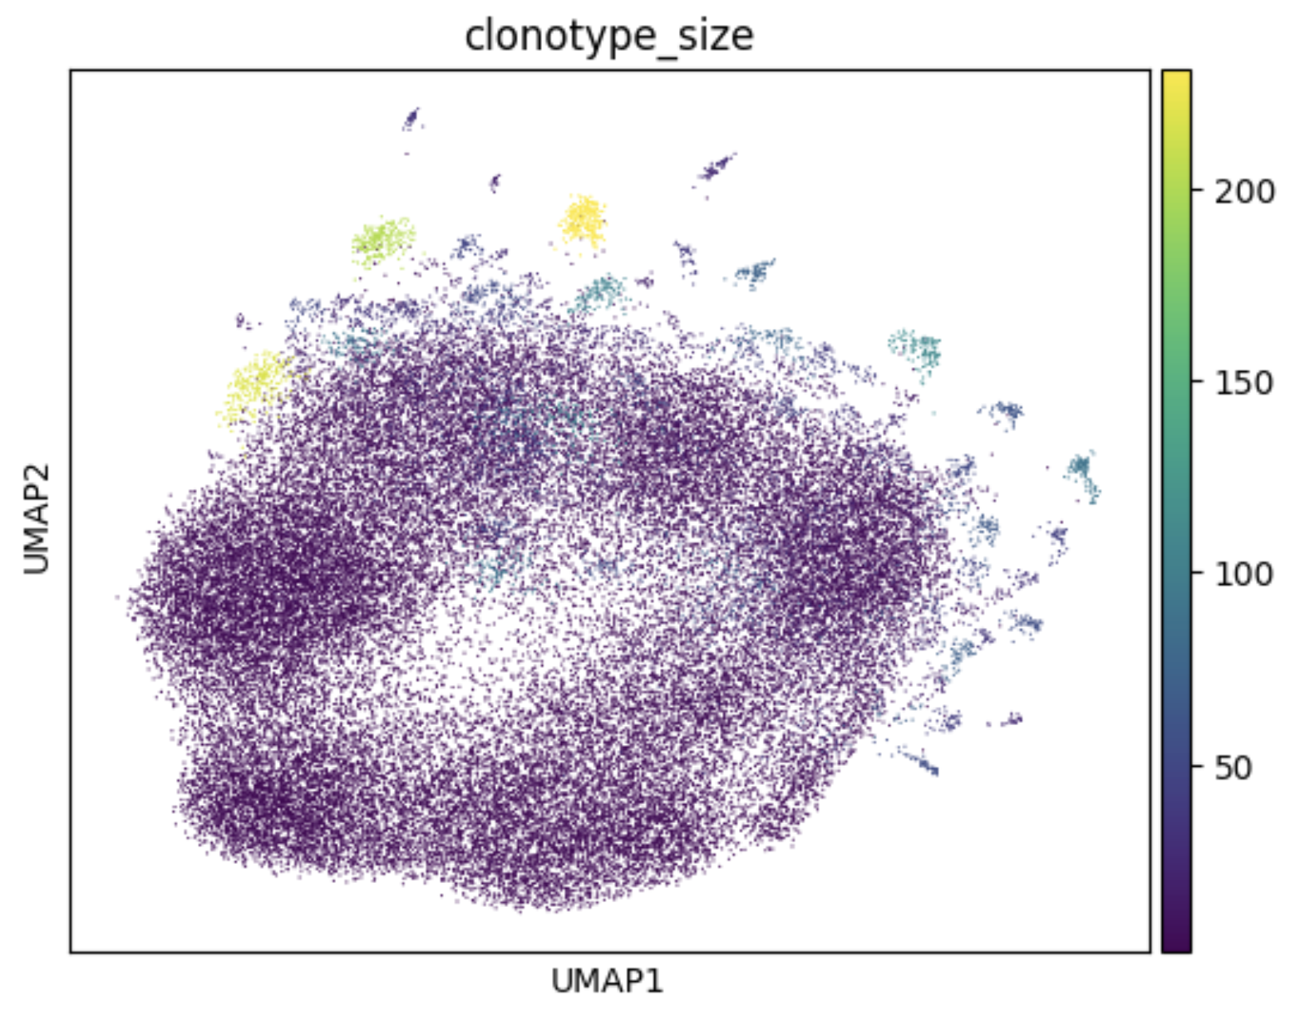
RNA+TCR (mvTCR) UMAP: clonotype size
Notes:
NEXT STEP: identify the DEGs/TCR feature differences of clusters which depend both on specificity and transcriptional signatures, DOING THIS BEFORE HERE SAW NO DEGS/TCR feature diffs BUT MAYBE NOW I WOULD SEE SOME DEGs

